Slide 1

Cultures of Programming Lessons from 70 years of learning how to control the electronic computer Tomas Petricek, University of Kent tomas@tomasp.net | @tomaspetricek

Slide 2
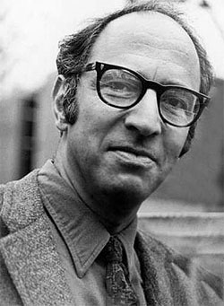
Structure of Scientific Revolutions (1962)
What differentiated these various schools was not one or another failure of method—they were all ‘scientific’—but what we shall come to call their incommensurable ways of seeing the world and of practicing science in it.
Thomas Kuhn

Slide 3
Different ways of programming?
Hacker culture
How to specify programs?
How to avoid program errors?
What are types good for?
How to make sure it works?
What is object-orientation?
What activity is programming?
Mathematical culture
Business culture
Engineering culture
Creative culture

Slide 4
Scene 1
ENIAC and EDSAC: Programming in the 1940s

Slide 5
T
It is 1946 and the ENIAC computer has just been introduced. This raises a question of how to program such machines?
B
Surely, building a computer can be outsourced to a sub-contractor like work on other scientific instruments!
H
This is hard… You have to fiddle with the machine and try things out!
M
I think you should figure things out logically before trying.
T
Did anything change in 1949 when the EDSAC computer was built?
H
It’s still the same, but punched cards make it a bit quicker to try things out!
E
Oh, but we could reduce the number of instructions by introducing subroutines!
B
Good, because this fiddling is expensive. Programs should be run by operators to use the machine effectively.

Slide 6
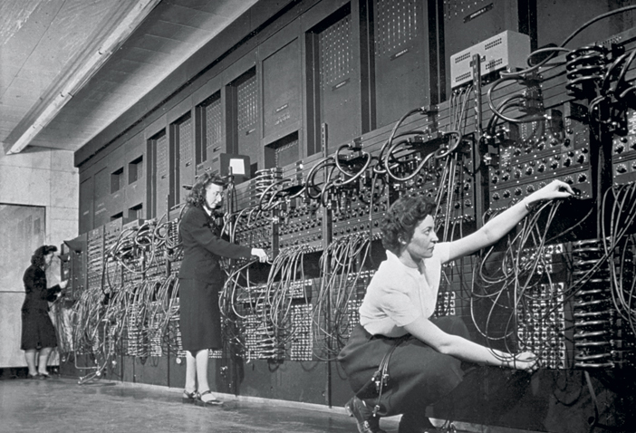
“The ENIAC was a son of a bitch to program” Betty Jean Jennings Bartik

Slide 7

Debugging the ENIAC
The ENIAC had (…) five buttons, which read “Start,” “Stop,” “Continuous,” (…) We could [also] disconnect one of the program-pulse output cables and stop it after a particular operation.
Many times we could not tell whether the ENIAC was making an error [because of a blown tube] or we had a bug in our program.
Betty Jean Jennings Bartik

Slide 8
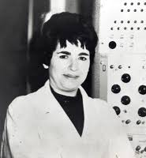
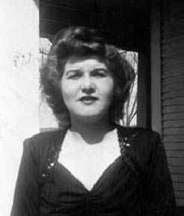
Hackers and Mathematicians
Adele [Goldstine] was an active type of programmer, trying things very quickly. I was more laid back and given to attempting to figure out things logically before doing anything.
Betty Jean Jennings Bartik

Slide 9
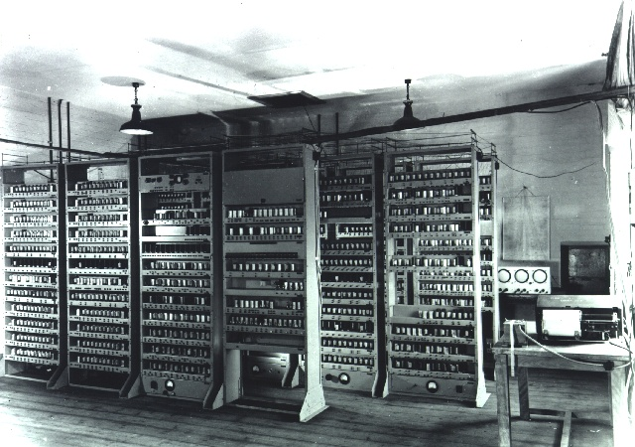
Programming the EDSAC
Completed in 1949 in Cambridge, UK
Designed as a stored program computer
Programmed using punched cards

Slide 10
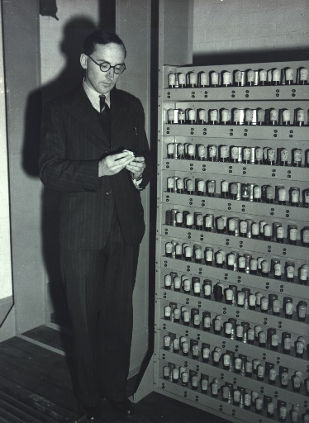
Debugging the EDSAC
The way to debug a program (…), was to sit at the console and execute the program manually, instruction by instruction, while observing the registers and memory on monitor tubes (…).
Martin Campbell-Kelly (2011)

Slide 11
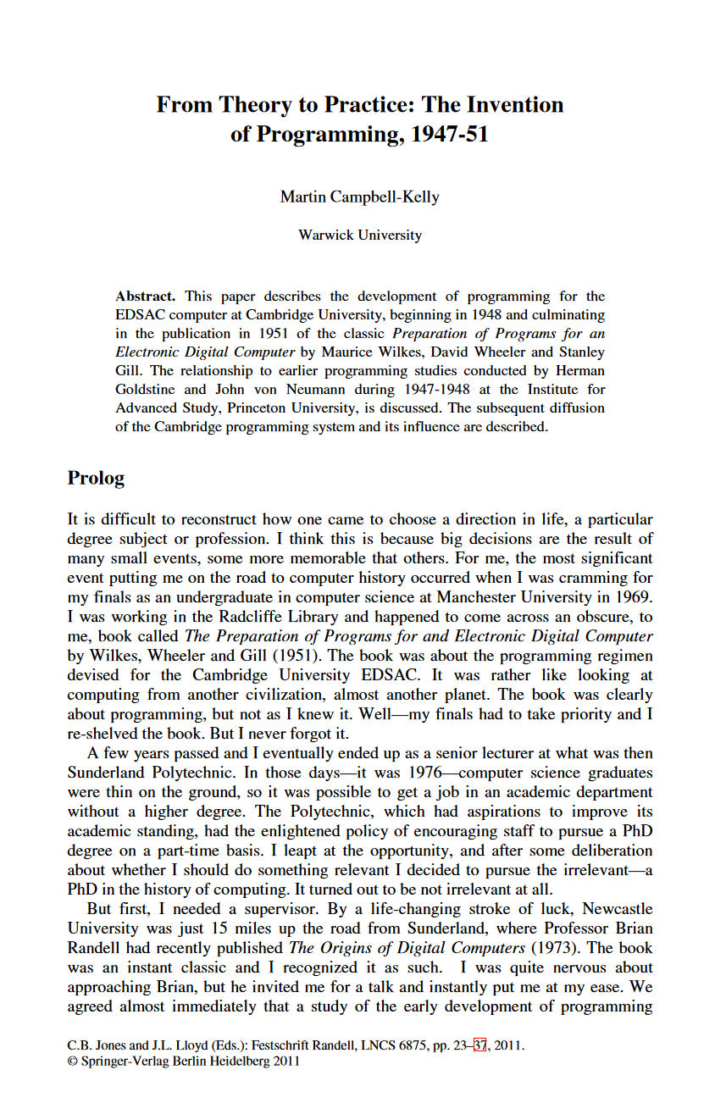
Debugging the EDSAC
Post-mortem routine – print out a region of the store so that it can be studied offline if program gores wrong.
Checking routine –program executed by an “interpreter” that printed diagnostic information
“From early 1950, it became possible to assign a full-time operator to the EDSAC who would run programs on behalf of users.”
Martin Campbell-Kelly (2011)

Slide 12
Hacker culture
Direct interaction with the machine, often using individual expertise.
Mathematical culture
Treat programming as mathematical challenge to be solved logically.
Engineering culture
Use the machine to build better tools for controlling, testing and debugging.
Business culture
Computers as a scientific instrument. Human processes to use it efficiently.

Slide 13
Scene 2
Time-sharing and minicomputers in 1950-1960s

Slide 14
T
It is 1956 and programming is done via batch processing, with the exception of experimental machines like TX-0. Is this the start of a computing revolution?
H
Absolutely. You can even modify program while sitting at the computer. A miracle!
B
Blocking a $3 million machine for hours? What a waste of resources.
E
Maybe we could enable the same interaction by letting multiple users work concurrently with a single machine?
C
Imagine if you could use computer like this in a classroom and use it to teach children about thinking!
H
Time-sharing may work fine for that, but for real interactive use that uses screen rather than terminal, computers need to become personal.

Slide 15
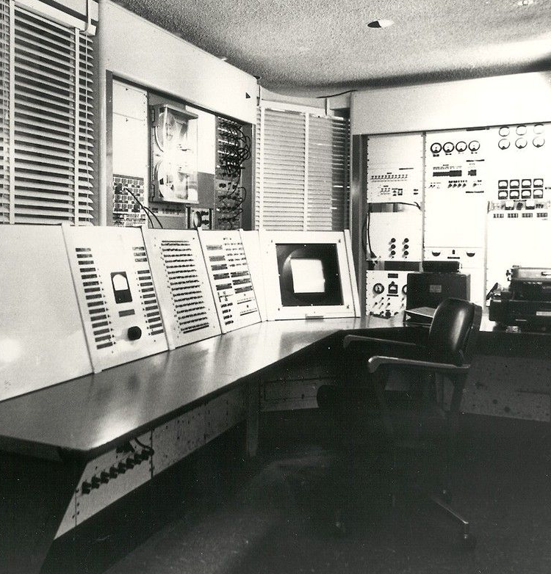
Programming TX family computers
Users debugged their programs right at the console, sitting there sometimes for hours (…) usually at night.
Using these features (…) Ivan Sutherland was constructing [Sketchpad] a system that displayed drawings with which users could interact (…) in real-time.
Severo Ornstein (2002)

Slide 16
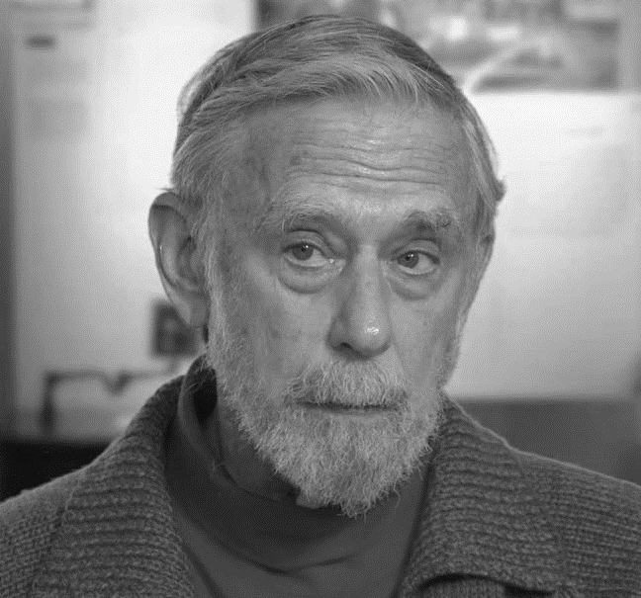
But interactive computing is expensive!
The Big Dealers solution was to divide up the machine’s cycles in such a way that many [remotely connected] users could use it at the same time.
Small Dealers felt that real-time, interactive use via a display was crucial and that Time-Sharing would never provide such capability.
Severo Ornstein (2002)

Slide 17
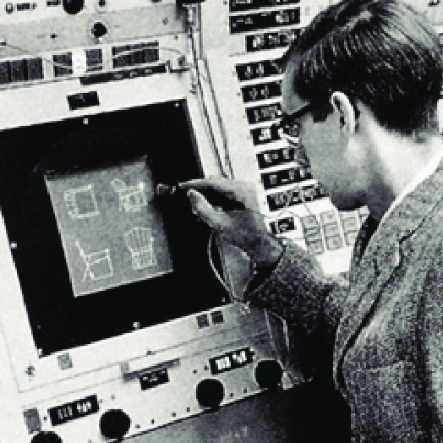
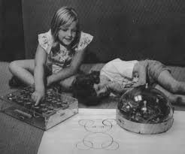
Creative culture enters the scene in 1960s
Sketchpad makes it possible for a man and a computer to converse rapidly through the medium of line drawings.
Ivan Sutherland (1963)
The LOGO classroom experience was a revelation! This was more like the environment of powerful epistemology, the environment of media.
Alan Kay (2013)

Slide 18
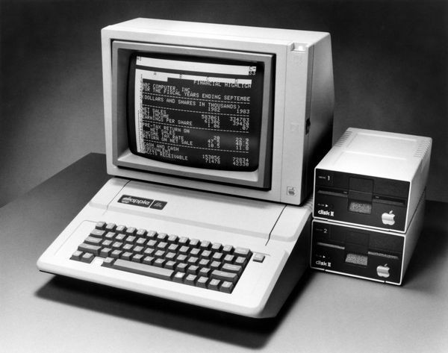
Business culture strikes back in 1970s
VisiCalc was one of two application products (with WordStar) that were (...) really the software underpinnings for the (…) explosive growth of the personal computer industry.
Burton Grad (2007)

Slide 19
Hacker culture
Explore computers for the sake of computers, requiring full control.
Business culture
Focus on business problems affects what interaction is supported.
Engineering culture
Again, solving computer-related problems by using the computer.
Creative culture
Use computers as new media and in unexpected ways, often in education.

Slide 20
Interlude
Why cultures of programming matter

Slide 21
Why cultures of programming
Past
Make sense of past developments!
Cultures clash as well as collaborate.
Present
Combine ways of problem solving.
Avoid cultural misunderstandings!
Past
Imagine unexplored new developments.
Know where to look for cool ideas.

Slide 22
Scene 3
What kind of activity is programming?

Slide 23
T
The very idea of a programming language is a metaphor. Is this just an accident?
M
Not an accident. To program is to manipulate terms in formal languages!
H
It is just bits in memory!
C
Children programming Turtle with LOGO do not think of formal languages. Programming is interacting – with the medium.
B
Does that mean users can arbitrarily change your programs!?
E
Even if programming is using a language, you can build various useful tools…
T
Is it decided then? Is programming like writing?
C
All creative uses of programming are interactive! But there is more – think about data science tooling.

Slide 24
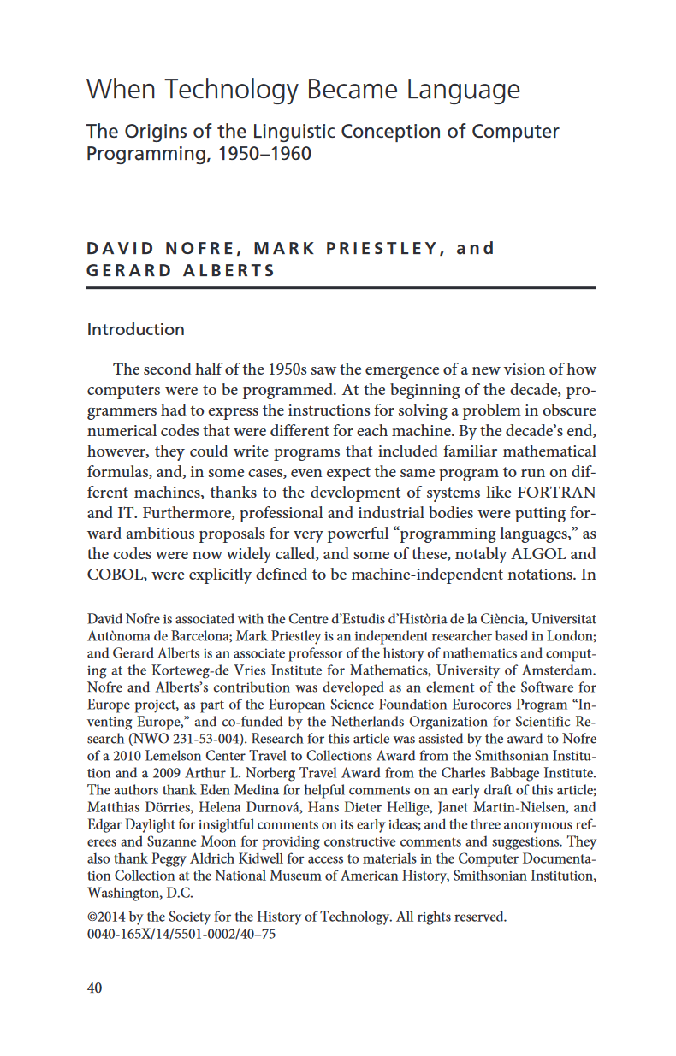
When technology became language
How it became natural to think of programming as a linguistic activity?”
From “programming notations as attributes of individual machines” to free-standing notations, drawing “on the disciplines of symbolic logic and linguistics” for their description.
Nofre et al. (2014)

Slide 25
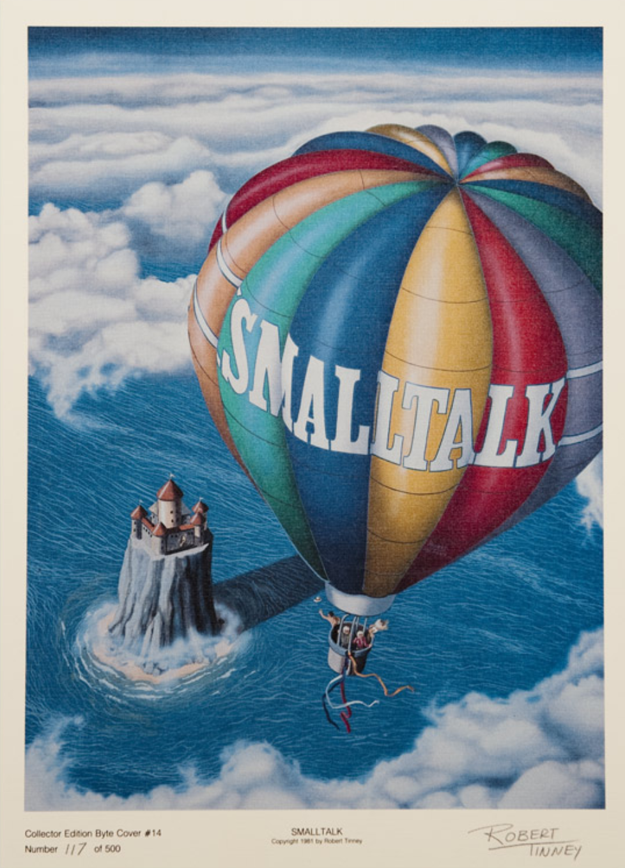
Creative origins of Smalltalk
“The purpose of the Smalltalk project is to provide computer support for the creative spirit in everyone.”
“If a system is to serve the creative spirit, it must be entirely comprehensible to a single individual.”
Dan Ingalls (1981)

Slide 26

Interacting with Smalltalk
“A user interface is simply a language in which most of the communication is visual.”
“Every component accessible to the user should (…) present itself in a meaningful way for observation and manipulation.”
Dan Ingalls (1981)

Slide 27
What killed Smalltalk?
Lack of a standard. “Each vendor had a slightly different version - not so much a different language, as a different platform.”
Deployment. “Smalltalk (…) computation takes place [in] a ‘sea of objects’. If you want to deploy an application by separating it from the IDE (to (…) protect your IP) it turns out to be very hard.
Gilad Bracha (2020)

Slide 28
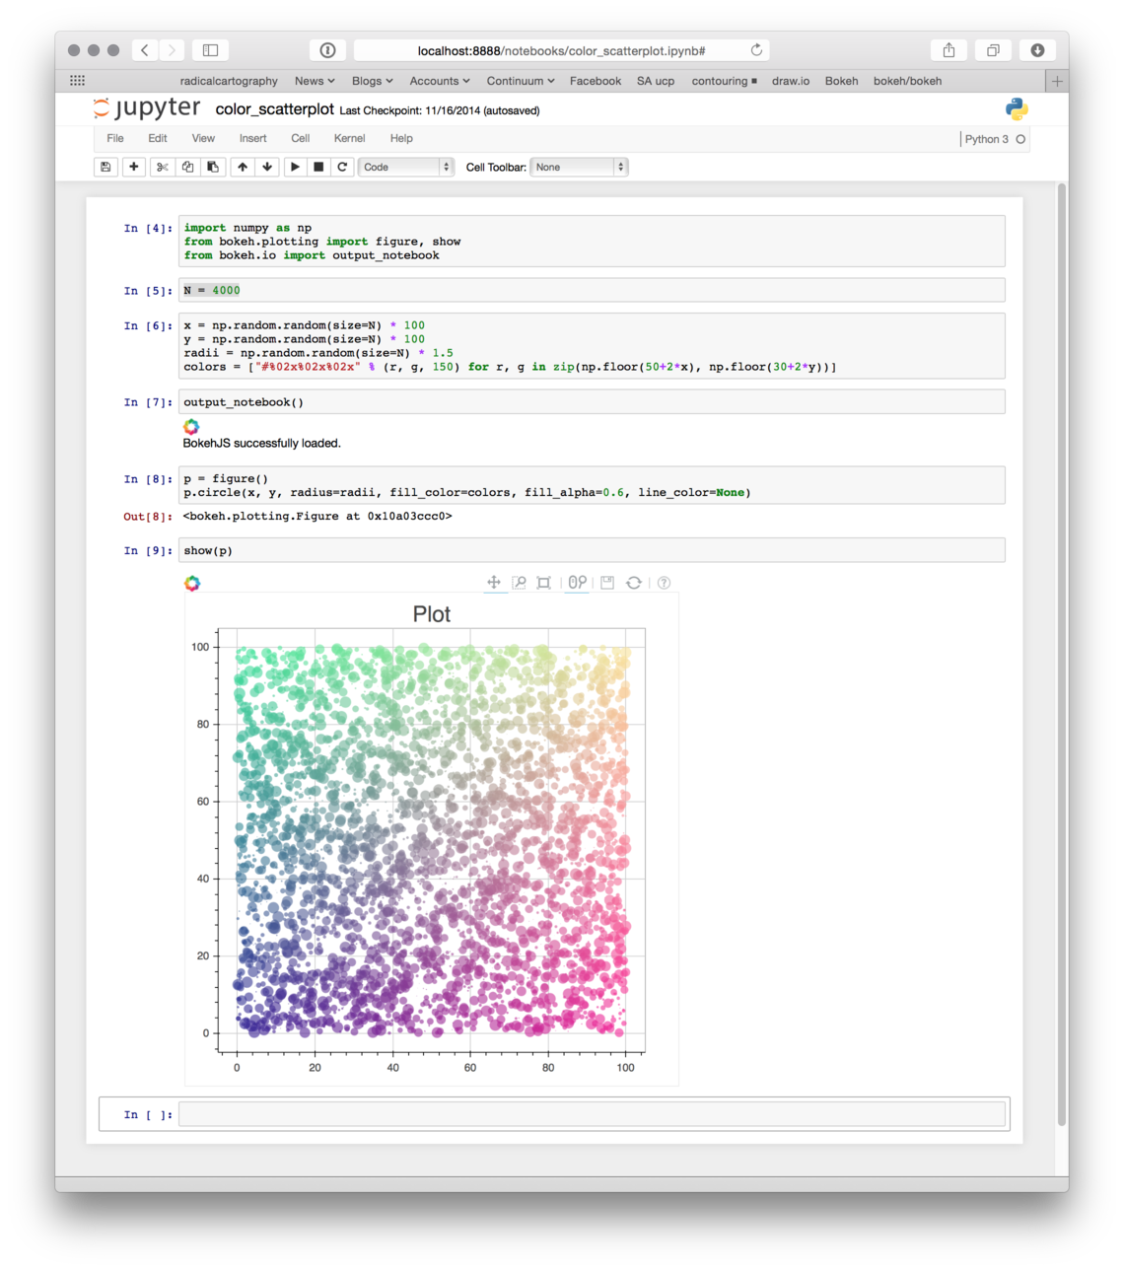
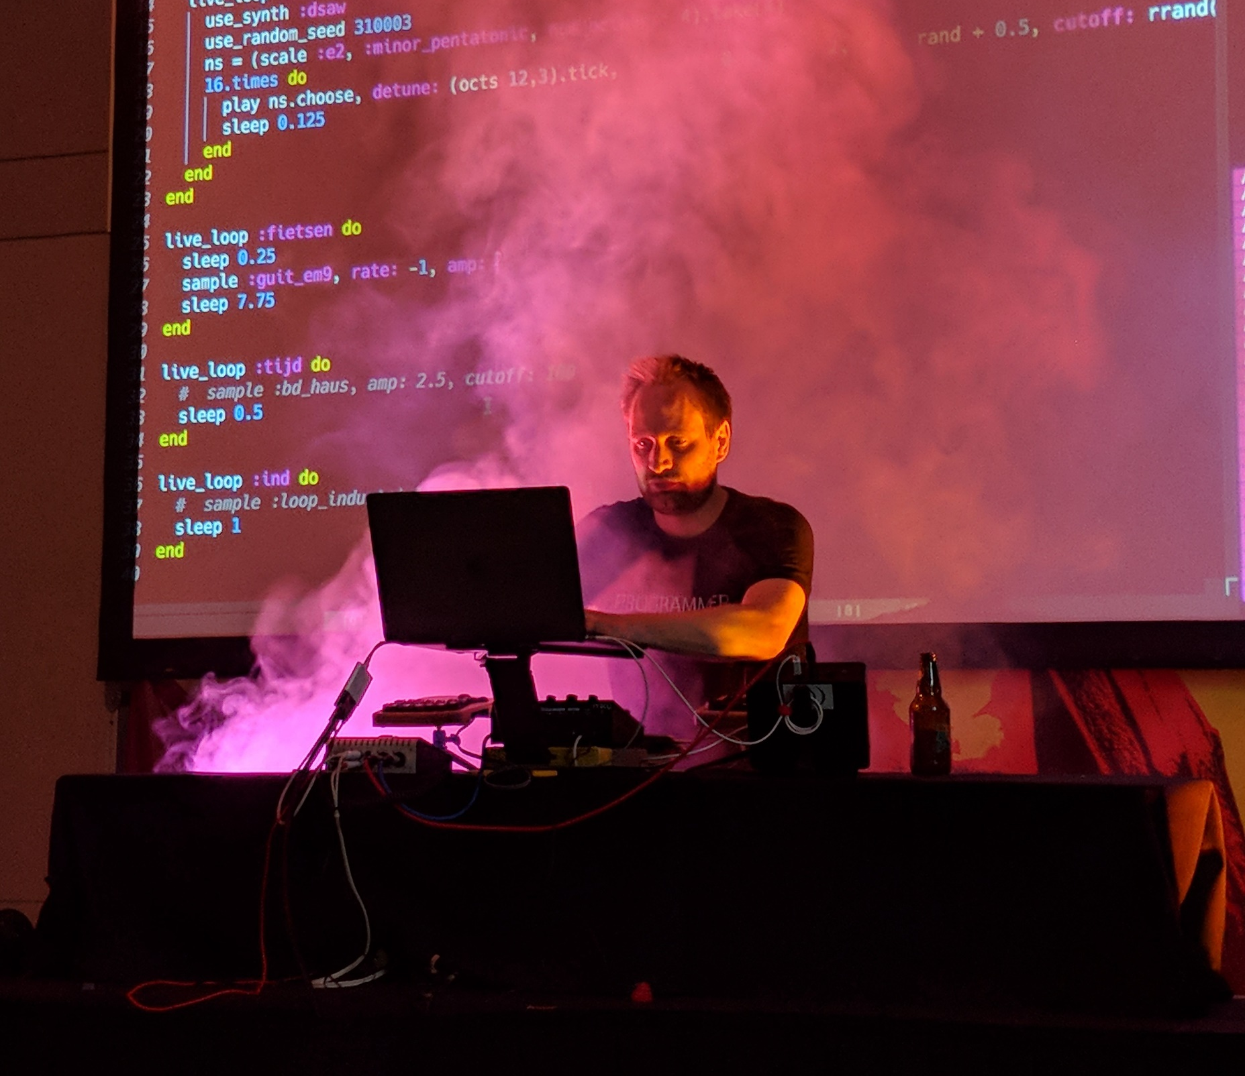
Where programming is still interacting?
Live coded music
Exploratory data analytics

Slide 29
Mathematical culture
Programming as a formal language works well for academic research!
Business culture
Programs as closed artifacts works well in the commercial setting.
Creative culture
Programs as interaction with dynamic medium allows more creative uses!
Hacker culture
Programs lists of bits let you see what actually goes on in a computer.

Slide 30
Conclusions
Making sense of programming past & future

Slide 31
Cultures of Programming
Are here to stay. After 70 years, it’s not just a sign of an immature field.
Interact in many ways. Clash over principles, collaborate to improve programming practice.
Help us understand. Controversies of the past, current debates on hiring, methodologies, etc.

Slide 32
Thank you! Mathematical, engineering, hacker, business and creative cultures to make sense of programming! Tomas Petricek, University of Kent tomas@tomasp.net | @tomaspetricek

